Slide 1
GPU power variability in
ML Systems
Ashwin Poduval
Rajesh Shashi Kumar
CS839: Adv. ML Systems, Spring 2022

Slide 2
Outline
Problem Statement
Approach
Evaluation
Observations
Work in Progress

Slide 3

Problem Statement
Power variation in systems can affect performance
Black box system for renting resources
Problems of scale which is important in large ML training
Exploiting scale central to the success of deep learning
Aggressive utilization goals by occupants could lead to coupled effects

Slide 4
Goals
Address systems reliability and explainability concerns
Important for performance efficiency and cost of deployment
Develop intuition about GPU DVFS
Define stressmark for characterization of power variability in multi-GPU systems

Slide 5
Approach
Define a strategy for data collection
Measurements:
Power variation!
Statistical variation
Effects to account for:
Spatial effects: Proximity of GPUs running workloads
Systems today does not account for placement awareness
Temporal effects: High parallel utilization across GPUs at the same time

Slide 6
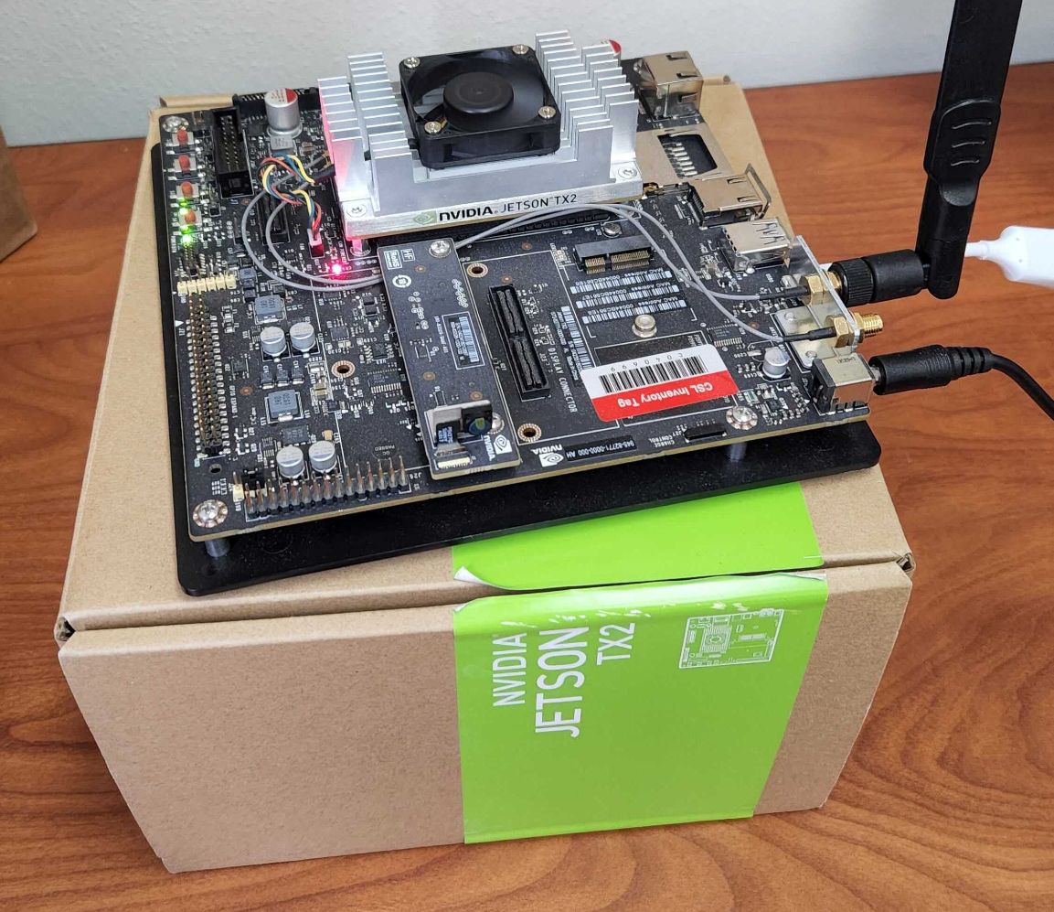
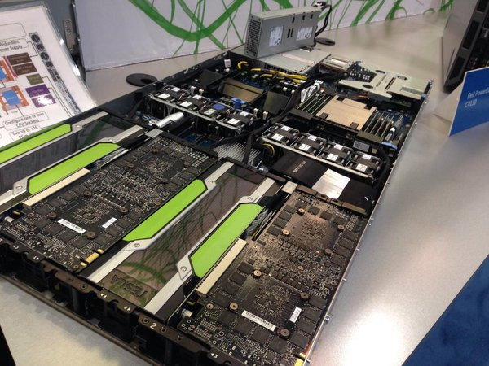
Approach: Cont’d
Two fold experiment space:
Jetson: Controlled
Understand performance variation with and without DVFS
CloudLab: Target system
4 GPU Node, run ML workloads maximizing utilization

Slide 7
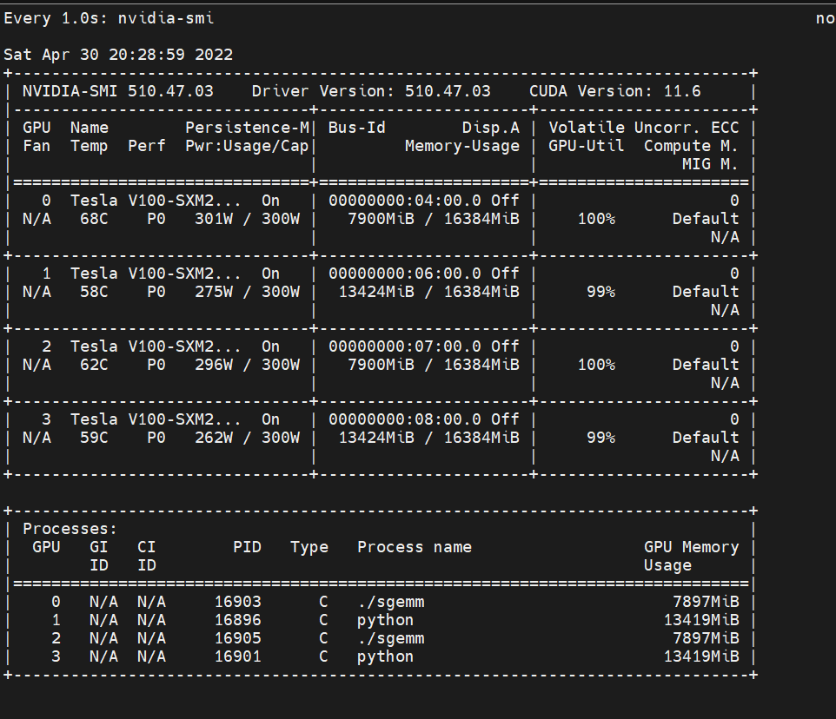
RESNET + SGEMM

Slide 8
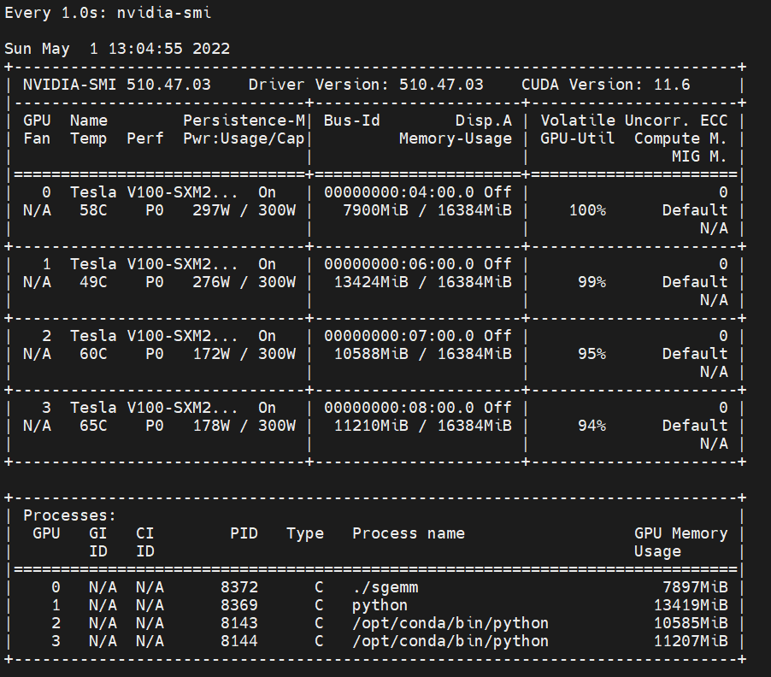
SGEMM+RESNET+DistTranformer

Slide 9
Evaluation
Workloads from the Nvidia DL repository:
Base:
SGEMM using cuBLAS
(25536)² matrix: 99.96% sm_efficiency
Noise:
RESNET50: Single node training, compute intensive
Imagenet, BS128
Transformer: Data parallel training, memory intensive
BS4096
CudaMemCpy: Synthetic data movement representation

Slide 10
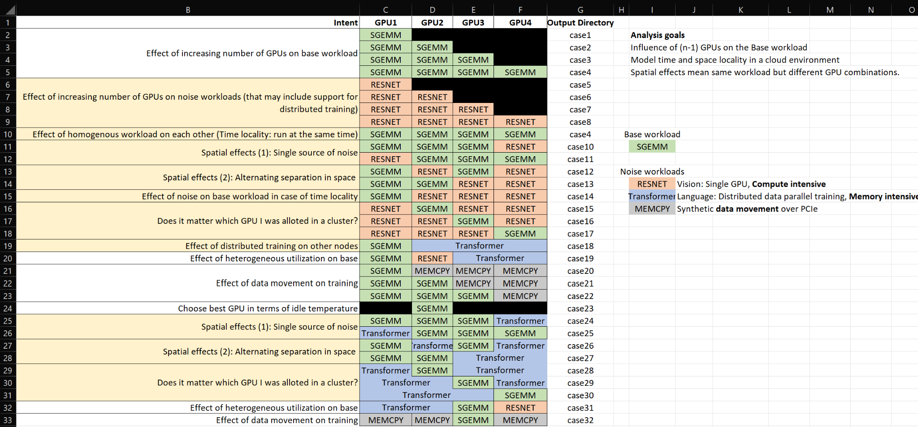

Slide 11
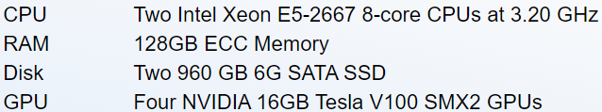
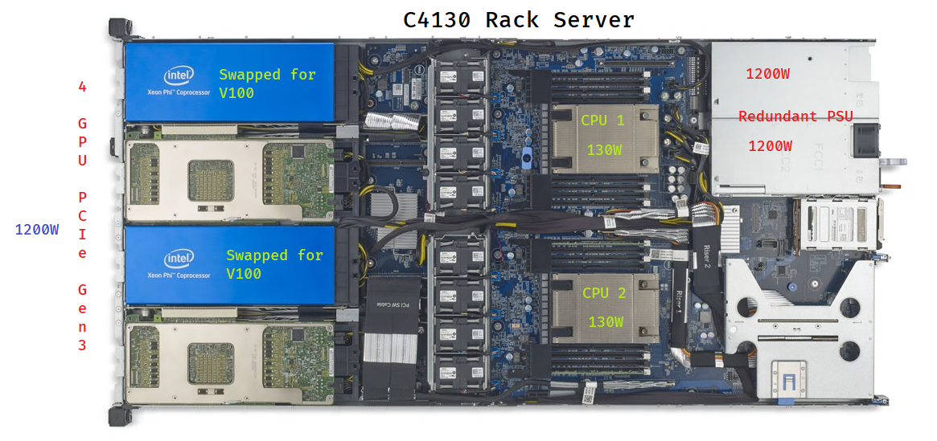
Experimental setup
https://www.wisc.cloudlab.us/portal/show-hardware.php?type=c4130 https://i.dell.com/sites/doccontent/shared-content/data-sheets/en/Documents/Dell-PowerEdge-C4130-Spec-Sheet.pdf
Notes:
It’s imperative to go through the system configuration for a bit considering our analysis maybe affected by it. Though the redundant PSU makes the system resilient to external variations, but the dynamic interaction between components can lead to variation

Slide 12
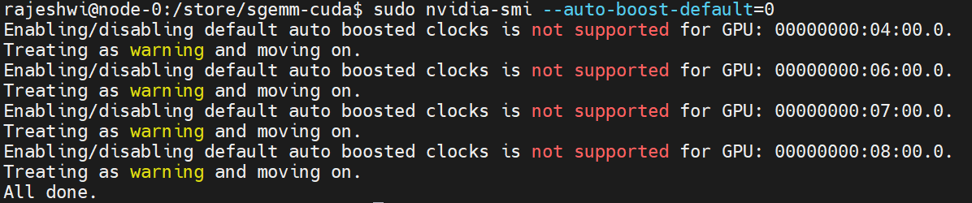
Experimental assumptions
Run profiling on all to ensure the same overheads across GPUs.
Variations can either be due to coupling in device physics or external factors
V100 does not support disabling autoboost
Observed power envelope overshoot upto 300+25W in many cases

Slide 13
Measurements
Primary components: Kernel runtime, Power
Second-order effects: Frequency, Temperature, Voltage

Slide 14
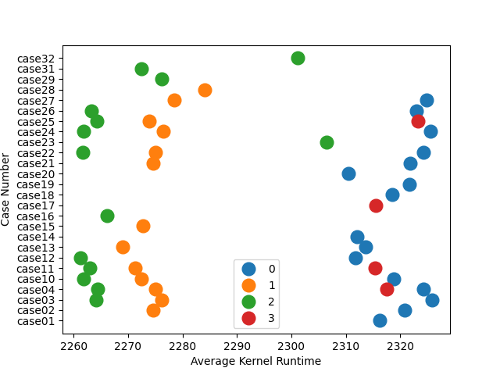
Average kernel runtime for BASE(SGEMM) workload
SGEMM kernel x 100 reps
Averaged over 2-4 runs
Key: Distinct pattern between GPUs perf even for small workload
GPU0 worst performer
GPU0,3 co-located?
3.5% variation in runtime (possibly more?)

Slide 15
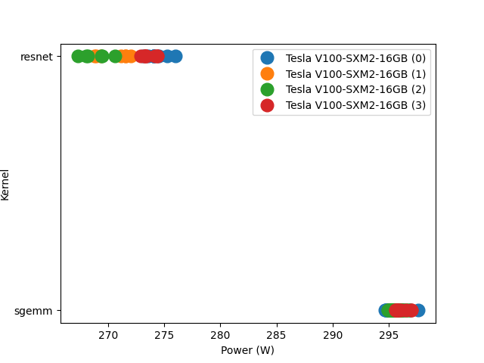
Average power consumption (RESNET50 + SGEMM)
GPU0 continues to be outlier
Pattern indicates variation is a measurable phenomenon
Both RESNET/SGEMM 100% util
Average lower for RESNET due to processing between iterations
But variability more in RESNET
Key: Variability exists both within workload and between workloads

Slide 16
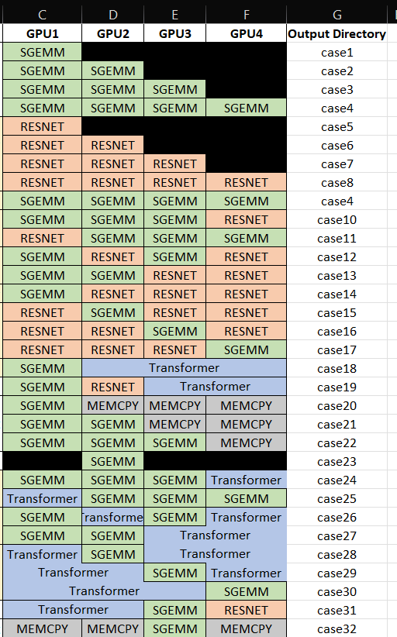
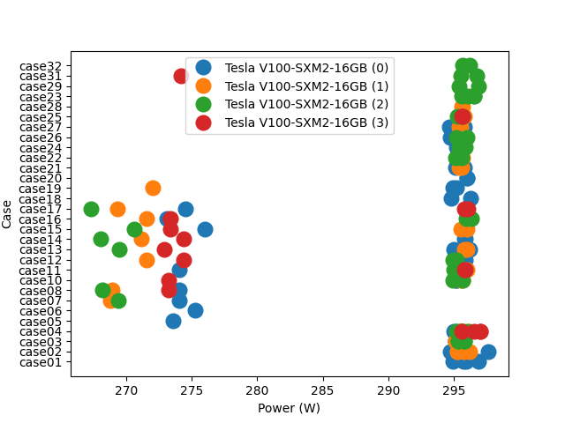
Average power consumption across workloads

Slide 17
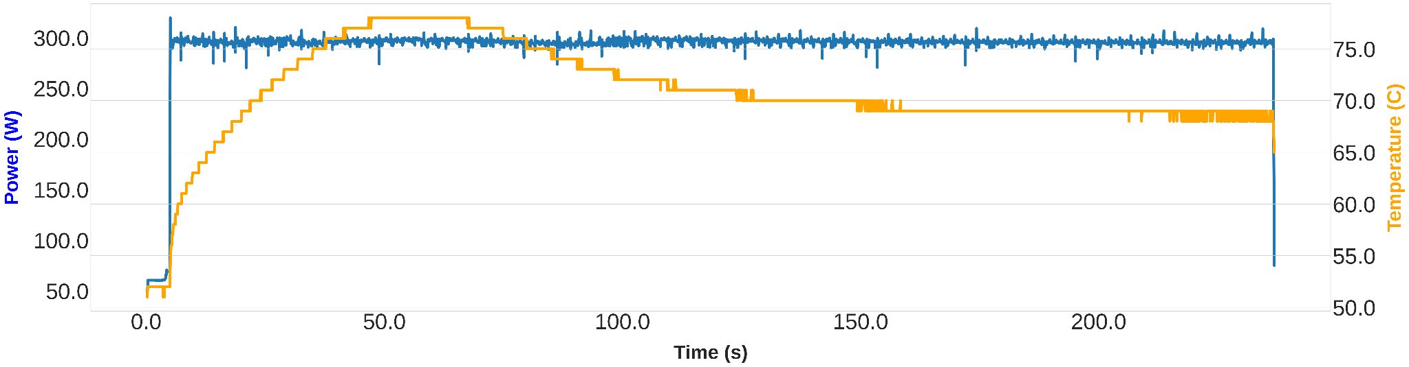
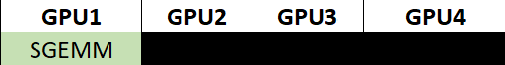
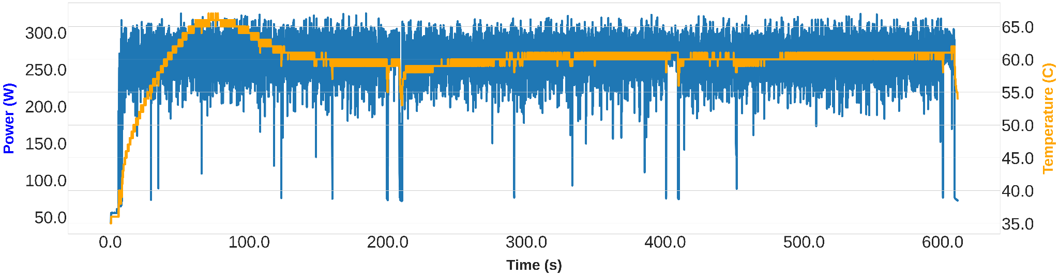
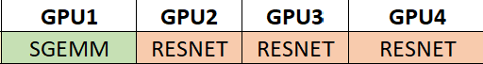
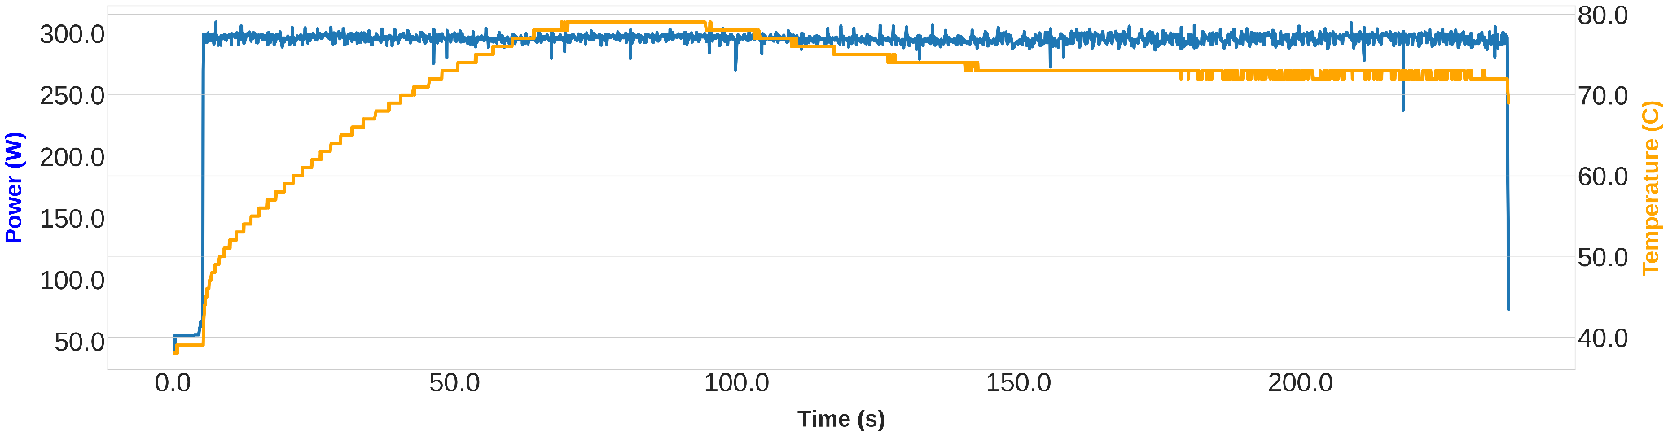
GPU0
GPU1
GPU0
Notes:
Please pardon me for data cramming here. Second order effect analysis is not trivial like the case of kernel runtimes

Slide 18
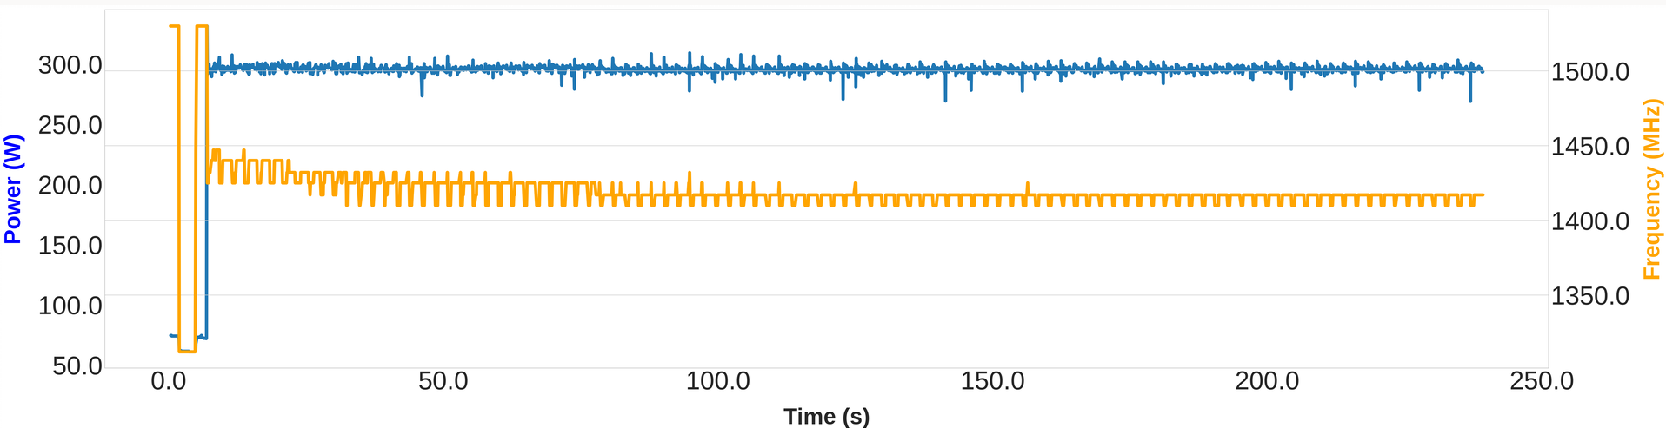
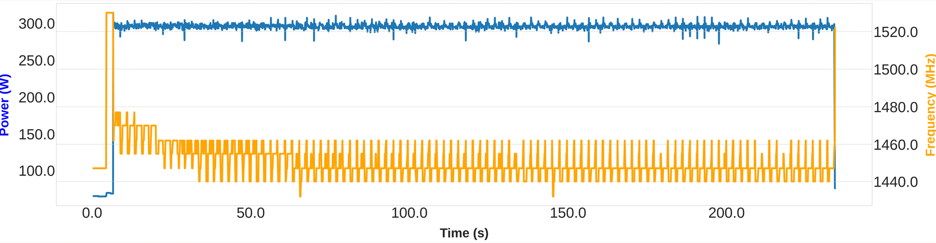
GPU1
GPU2

Slide 19
Pick a number between 0 and 3
Given 4 GPUs which one would you like to pick for a single node training?
Almost never a good idea to pick 0. Why?

Slide 20
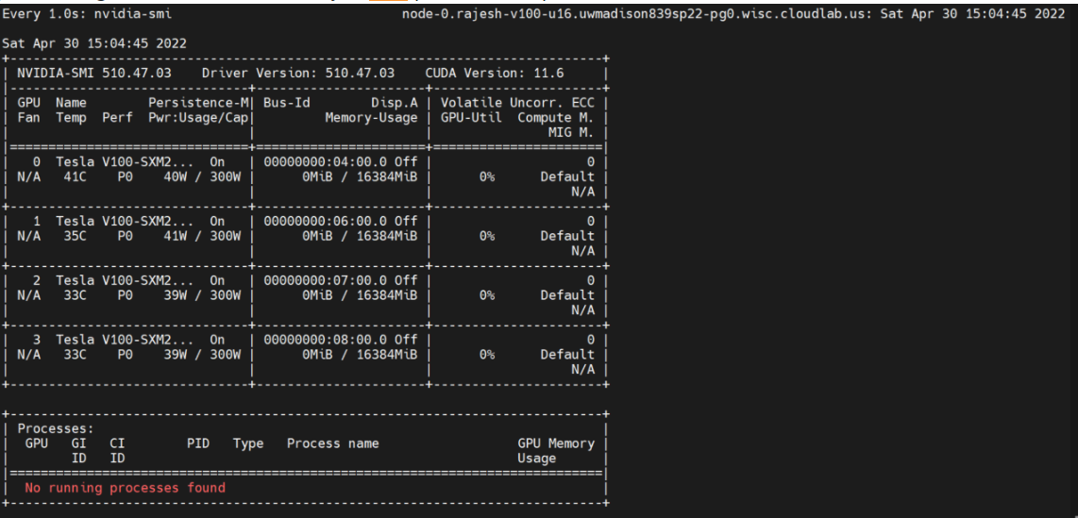
Idle conditions

Slide 21
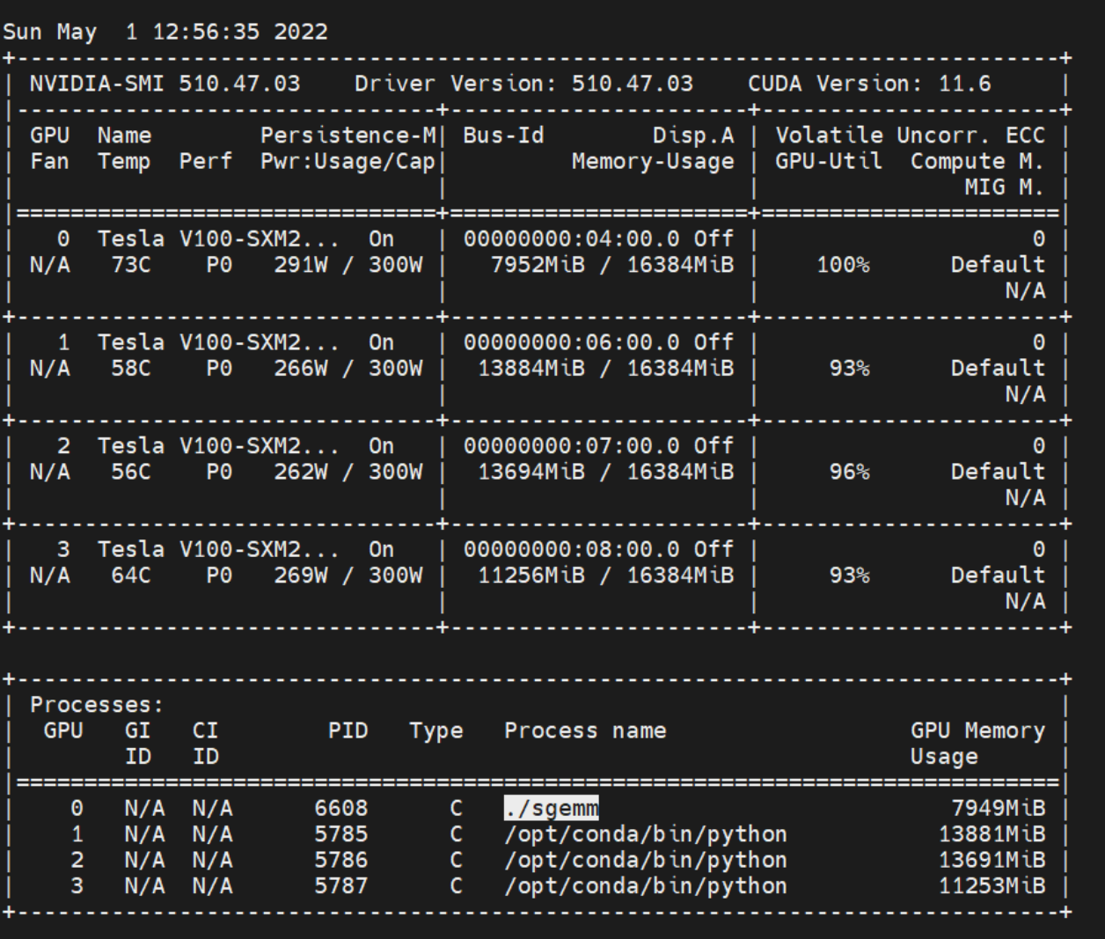
Scheduling makes a difference! Transformer + SGEMM (runs hot)

Slide 22
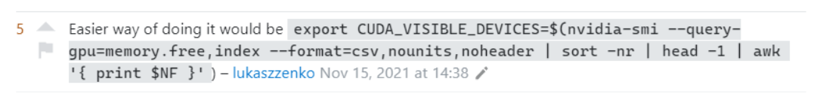

Slide 23
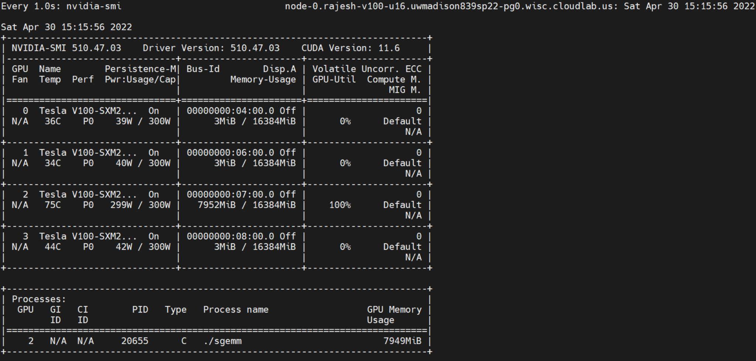
Spatial interference! Closer GPUs running hotter

Slide 24
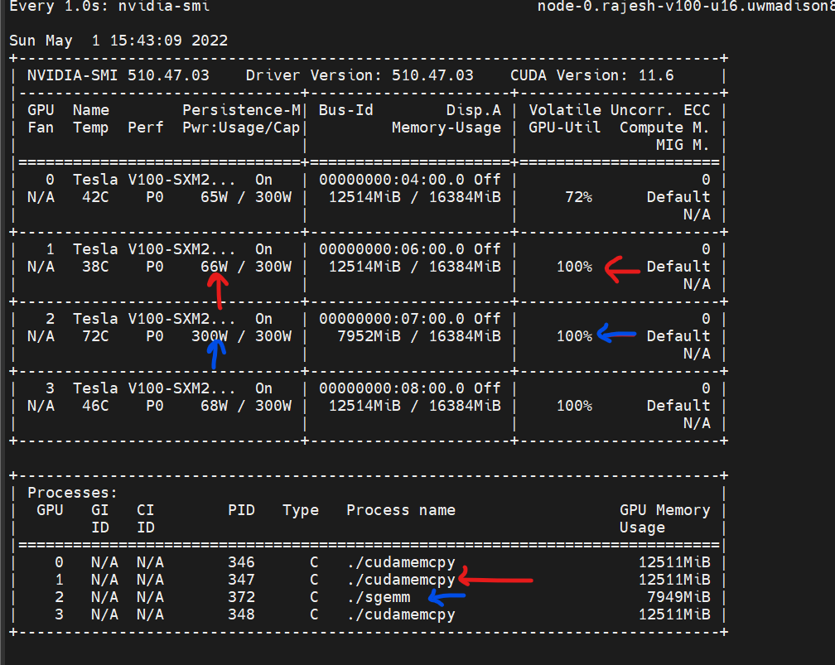
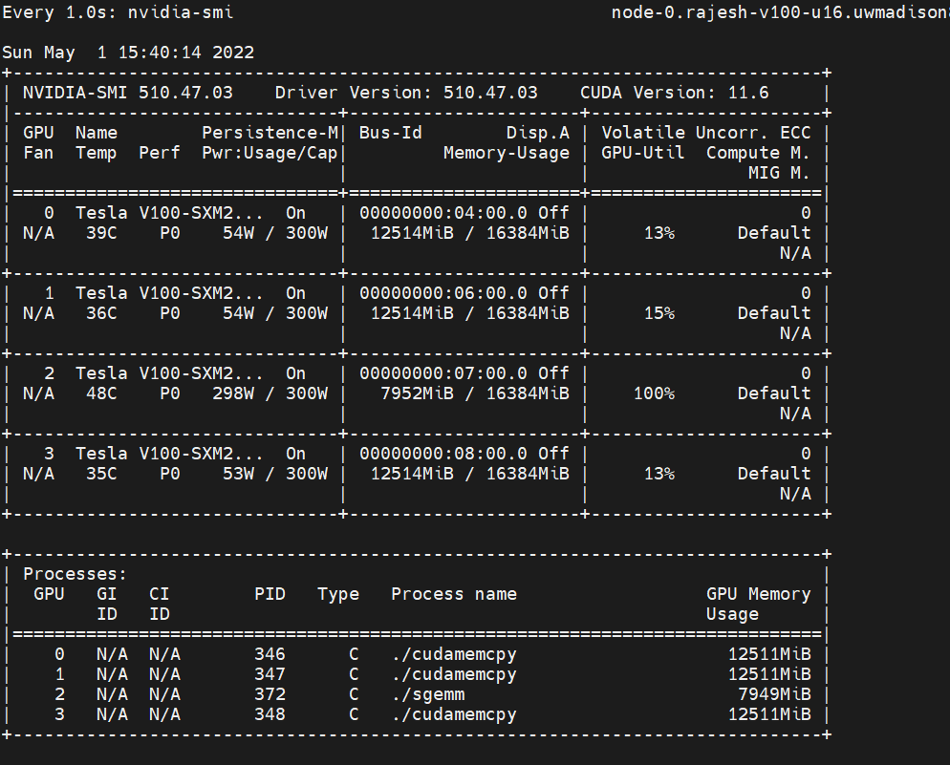
What is volatile utilization? Not a measure of achieved_occupancy

Slide 25
Work in Progress
Data correlation from all experiments
Visualization is key to understand second-order effects
Formalize observations into device/application agnostic insights
Derive actions from current data to define future work
Extensible beyond synthetic SGEMM through reusable stressmark
Performance predictability: Effect of variation on tail latency
Real-time profiling to guide mitigation
https://github.com/rajesh-s/mlsys-gpu-power-variability

Slide 26
Backup slides

Slide 27

Observed overshoot over 300W

Slide 28
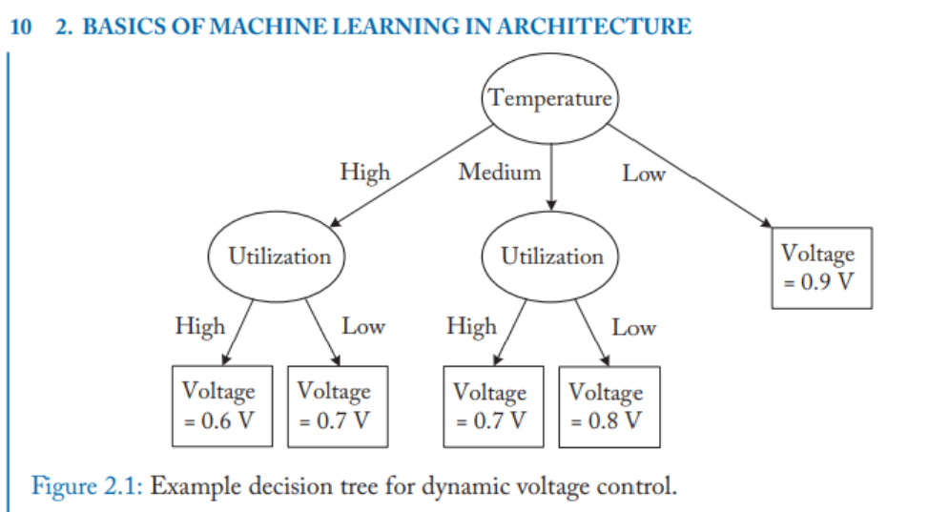

Slide 29
